Slide 1
Prediction of Stock Market Prices
Student: Toma Joksimovic 2016/201222
Professor: Milan Milosavljevic
Course: Artifical Intelligence

Slide 2
What problem is solved?
LSTM Neural Network is optimized type of Reccurent Neural Network which have solved the Vanishing Gradient Problem, where in RNN after learning with too long sequnce of data, our gradients become too small after Backpropagation algorithm.
LSTM solves this problem with internal memory, so it can memorize data for a long-term.
With LSTM we have solved problem of extremely hard and exhausting analysis of Stock Market indicators by humans for predicting future flow of the Stock Market as the main goal.
It shows that machines fastly process huge amount of data, building patterns after finding dependencies in data features.
LSTM shows great accuracy in prediction, inspite of being slower than RNN.

Slide 3
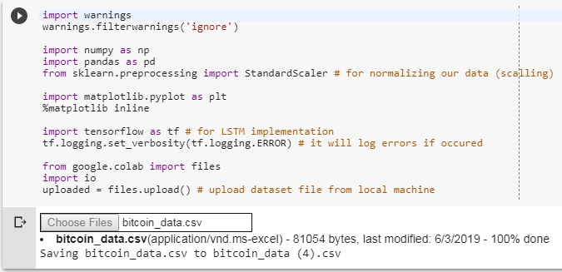
Tools and libraries
Google Colaboratory as development environment with GPUs (SaaS + IaaS), setting Hardware accelerator to TPU (Tensor Processing Unit) which is now in Beta version but it is stronger that the strongest NVIDIA GPU.
Programming language: Python 3.6
Libraries:

Slide 4
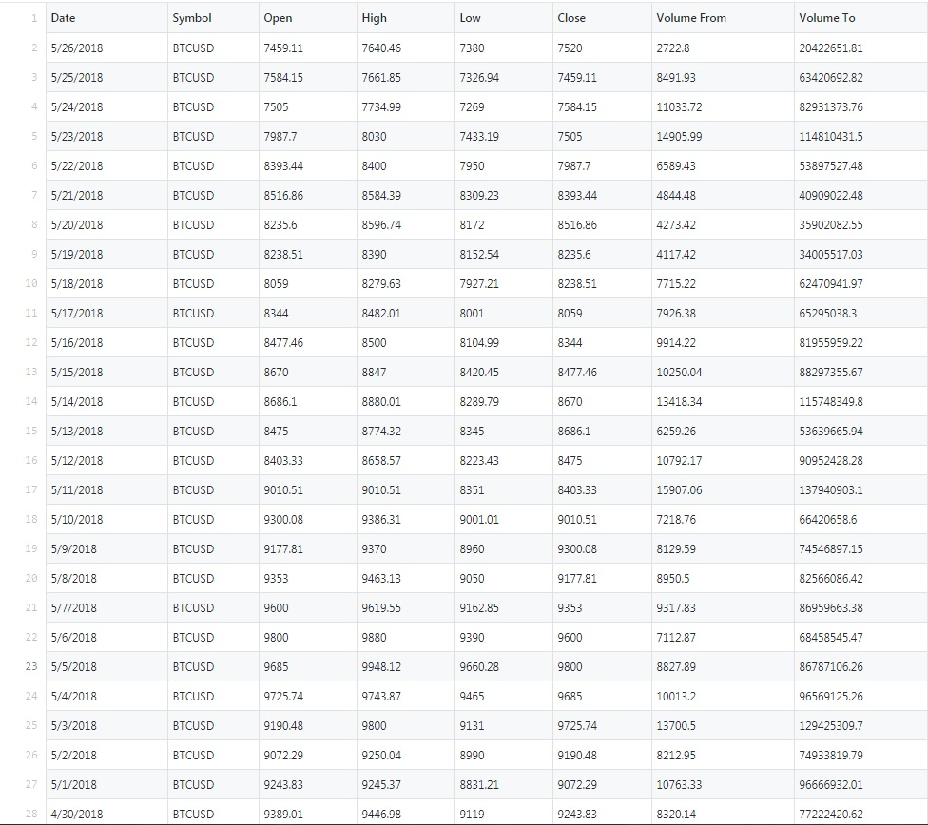
Data Source
Downloaded from historical data on website: http://www.cryptodatadownload.com/data/
Bitcoin data from December 2014 to May 2018 in CSV file (1273 records)

Slide 5
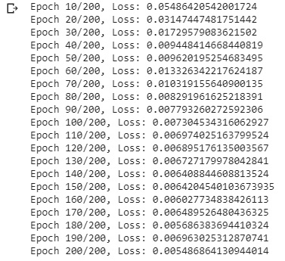
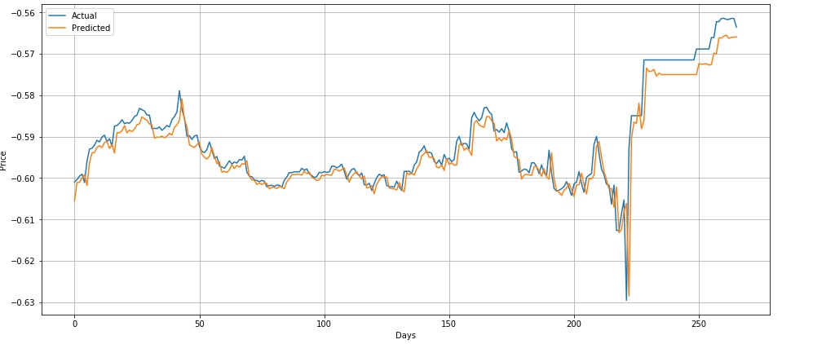
Results
First we will show results of training LSTM Neural Network
with 1000 samples of training set and 200 epochs (forward and
backward propagations our model needs to make).
At the end in 200th epoch our loss is only 0.00548..
But we can see that after 140 epochs our algorithm is getting stuck
With plateau and climbing little bit up to the hill, but at the end we
Will reach the minimum of all losses before.
At the end we can see on the graph how our training and predictions are getting more closer to the actual values as moving forward to the right with the test set.

Slide 6
Conclusion
This program can optimize even more. Practically we can never guess with 100% actual and future values.
Practically we would need a lot more different data from different formal and informal sources (all data about some companies, currencies, or other stocks, for some stocks we even need tweets, news).
We wolud even need privacy and secured data of some companies or banks to have the best future predictions which is not actually possible except having Spyware programs that runs distributed on all devices and machines of business people and sending that to AI cluster of servers for processing and feeding network for improving predictions.
However LSTM is really efficient network for predicting stock prices and other time series predicting as Speech Recognition, Image Captioning, Text transcripting and Language Translation, or other structural data.

Slide 7
Literature
https://en.wikipedia.org/wiki/Long_short-term_memory
https://dashee87.github.io/deep%20learning/python/predicting-cryptocurrency-prices-with-deep-learning/
https://colah.github.io/posts/2015-08-Understanding-LSTMs/
https://www.youtube.com/watch?v=zwqwlR48ztQ
https://www.youtube.com/watch?v=2np77NOdnwk
Univerzitet Singidunum, “Veštačka Inteligencija” – Milan Milosavljević
https://medium.com/@anishsingh20/the-vanishing-gradient-problem-48ae7f501257
https://towardsdatascience.com/recurrent-neural-networks-d4642c9bc7ce
https://skymind.ai/wiki/lstm
https://medium.com/explore-artificial-intelligence/an-introduction-to-recurrent-neural-networks-72c97bf0912

Slide 8
Thank you for attention !

